Slide 1
IMU & Sensor Fusion Workshop
Manohar Kuse (http://kusemanohar.info)
26th Aug, 2020

Slide 2
Outline
Basics of Optimization
Example with image feature matching and huber norms
IMU Dead reckoning
IMU factors in Optimization / Theory of IMU Preintegration
GTSAM example codes

Slide 3
Basics of Optimization

Slide 4
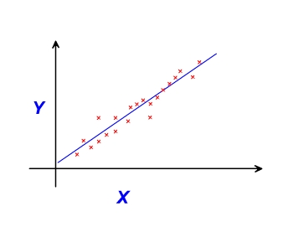
Example-1: Line fitting as Least Squares
Observations: (x0,y0), (x1,y1), …., (xn,yn)
Optimization Variables: m, c
Residue function for obs_i: m*(x_i) + c - y_i

Slide 5

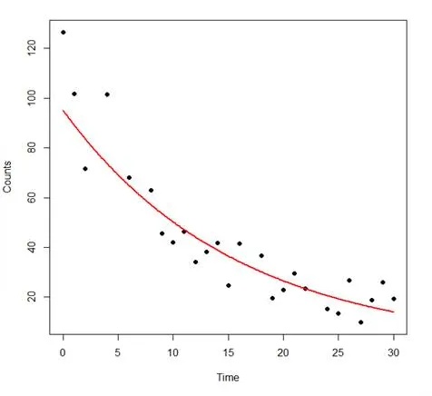
Example-2: Exponential Linear
Observations?
Optimization Variables?
Residue?

Slide 6
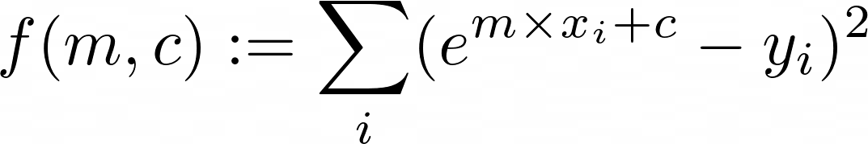
Continued….
Optimization Variables
How to get optimal m, c?
→ Could try to get gradients of this and try to set it to zero
→ gradient descent
Observations

Slide 7
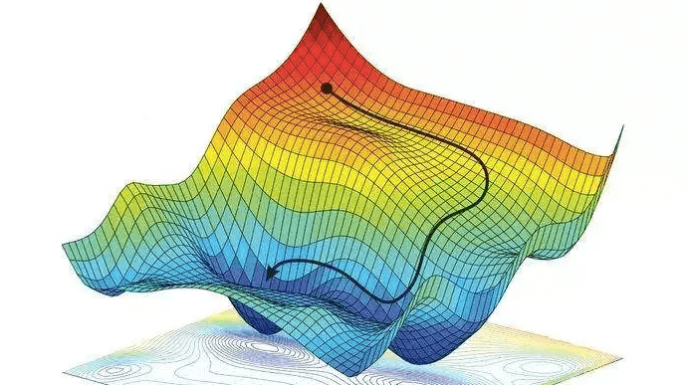
Continued...
Start with some reasonable guess...linearize...iterate
Variants of Gauss Newton Method

Slide 8
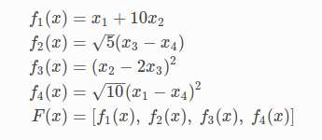
Example-3: Complicated Multi dimensional
Minimize || F(x) ||^2
Optimization Variables?
Observations?
Residue?

Slide 9
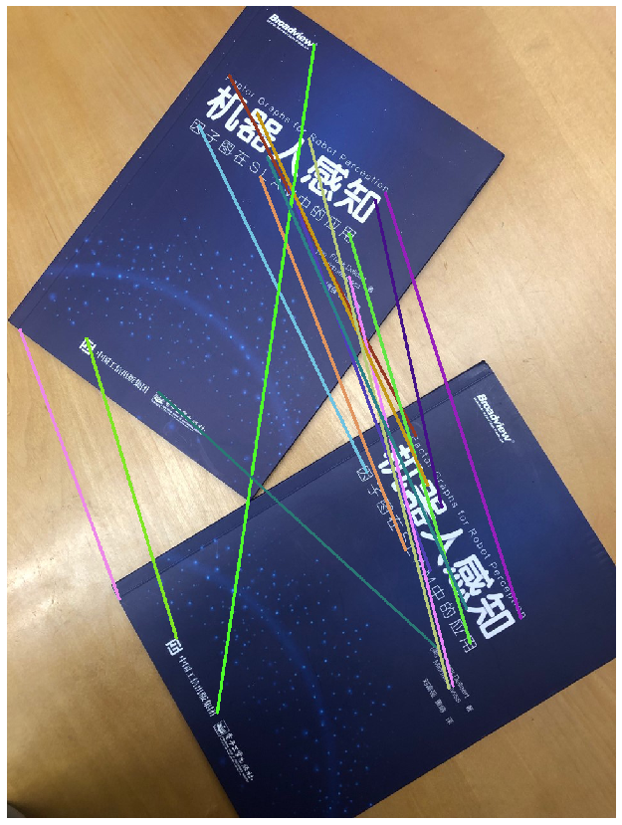
Example-4: Transform
from feature matching
Given: Feature correspondences
(20,30) <-> (60,80)
(26,33) <-> (73,91)
.
.
(u,v) <-> (u’,v’)
Estimate:
[ u ] = H [ u’ ]
[ v ] [ v’ ]
Borrowed from : https://gtsam.org/2019/09/20/robust-noise-model.html

Slide 10
See a problem as a non-linear least squares fitting
Identify:
Optimization variables
Observations
Residue functions
Dealing with Noise: There are several ways
(most common way) use of robust norms like huber norm.
See this on how to achieve this with gtsam:https://gtsam.org/2019/09/20/robust-noise-model.html )

Slide 11
Common Tools to Solve Non-linear Least Squares in SLAM Community
Ceres Solver (Google Inc)
  Good documentation, tutorial, community
  Few IMU related factors
  No incremental solver (big turn off for our case)
  Geared towards bundle adjustment and offline 3d reconstruction like problems
GTSAM (GATech)
  Documentation is bad, no tutorial, very steep learning curve, rude community (expect no help)
  Syntax is a little more cryptic (it uses traits and functors which I have no real idea about)
  Has Imu related factors already implemented.
  iSAM2 (yayyyah…!)
  Geared towards robotic state estimation

Slide 12
Example code for a sample problem
What it takes?
Defining the optimization variables
Defining the residue function
Constructing factor graph (aka residue terms)
Set initial estimates for the optimization variables
Solve
Retrieve results
Lets try to look at the code for an example problem:
X: [ (x0,y0), (x1,y1), …, (xn,yn)
Y: [ (x0,y0), (x1,y1), …, (xn,yn)
Fit a 2d Pose: Y_i ~ Tr * X_i

Slide 13
Ceres Solver Code
All example codes: https://github.com/mpkuse/advanced_techniques_for_curvefitting
Alignment problem:
https://github.com/mpkuse/advanced_techniques_for_curvefitting/blob/master/align3d3d.cpp

Slide 14
GTSAM Code
https://github.com/mpkuse/gtsam_standalone
Alignment Problem:
https://github.com/mpkuse/gtsam_standalone/blob/master/expression_factors/2_expfac_fitpos2.cpp

Slide 15
Least Squares and Maximum Likelihood (MLE) and Maximum A Posteriori (MAP)

Slide 16
2. IMU Measurements
Went on to found the company “Agerris” - Agriculture Ground Robots in Australia
Went on to create GTSAM (first released in 2010) and then Skydio
My PhD lab. A complete parallel theory essentially same as gtsam. Lab code powers DJI drones navigation
Authoritative Reference for IMU based sensor fusion in Robotics:
Lupton, Todd, and Salah Sukkarieh. "Visual-inertial-aided navigation for high-dynamic motion in built environments without initial conditions." IEEE Transactions on Robotics 28.1 (2011): 61-76.
Forster, Christian, et al. "On-Manifold Preintegration for Real-Time Visual--Inertial Odometry." IEEE Transactions on Robotics 33.1 (2016): 1-21.
Qin, Tong, Peiliang Li, and Shaojie Shen. "Vins-mono: A robust and versatile monocular visual-inertial state estimator." IEEE Transactions on Robotics 34.4 (2018): 1004-1020.

Slide 17
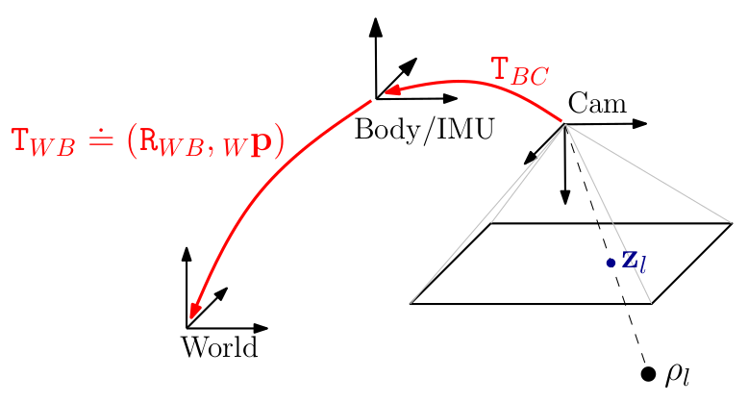
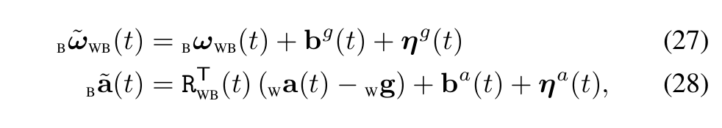
What IMU Measures
Eq. borrowed from [2]
Linear Acceleration of imu-body wrt to
FLU (FLU=front-left-up)
Angular Velocity
Output of the IMU
Gravity
(in FLU)
biases
noise
True values
(in FLU frame)

Slide 18
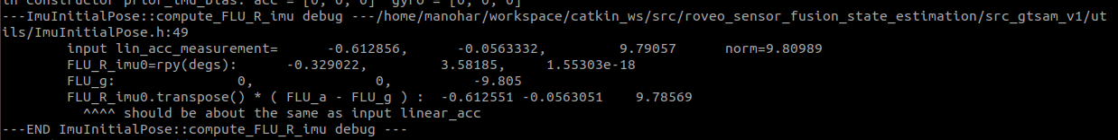
Assuming initially IMU is rest, how to calculate FLU_T_imu
Eq. borrowed from [2]
b_a_tilde(t) = (w_R_b)^T * ( 0 - [0,0,-9.805] )

Slide 19
3. Concept of IMU Preintegration

Slide 20
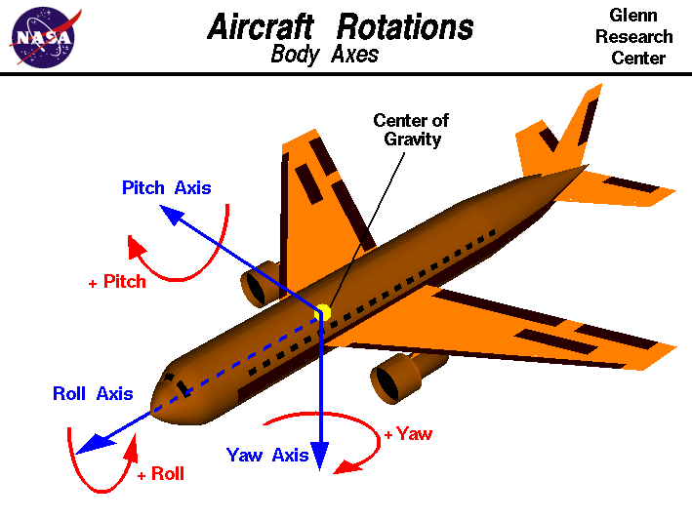
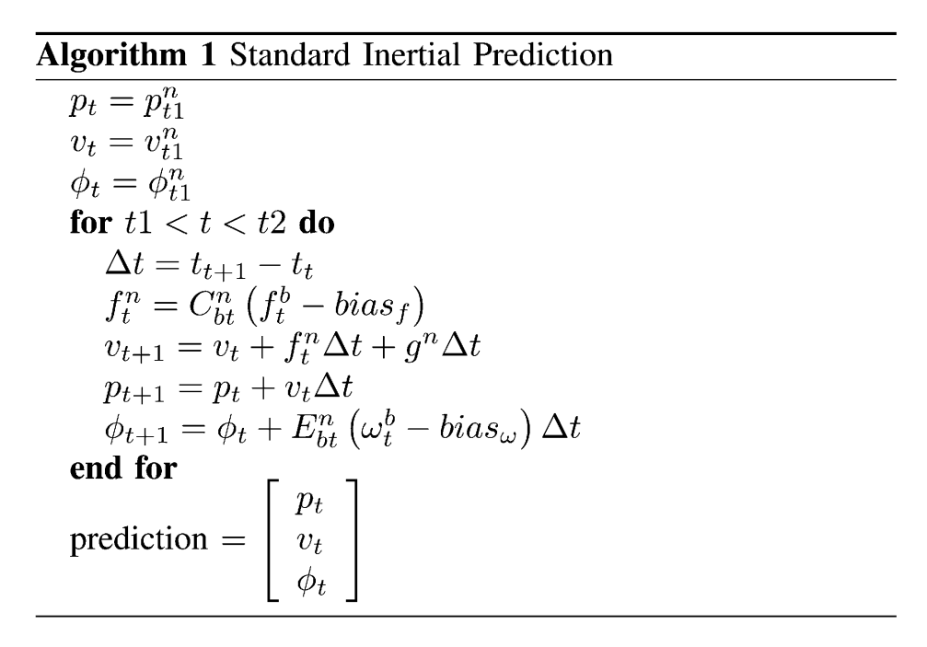
IMU Dead Reckoning
Eq. borrowed from [1]
Note: aircraft frame is NED and not FLU. Be careful when using equations from Aerospace books.
Note: we use the ZXY euler angles, whenever possible quaternions to represent rotation

Slide 21
In Robotics Context
The previous algorithm was good for aircraft/missile navigation
  Very very high quality IMUs
  Zero drift, so position just from dead reckoning was accurate
Come cheap IMUs and dead reckoning gives garbage
  Roboticist need a way to compute relative poses with imu measurements (say between t=100ms & t=200ms).
  If we could compute relatives poses with imu, it could serve as observations for our least-squares fit.
  In current form, it is impossible to compute relative poses only with IMU data
  The “theory of IMU-preintegration” gives a way to compute pseudo imu relative poses which can be used in non-linear least squares optimization.

Slide 22
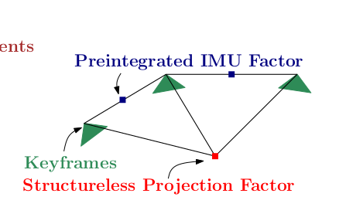
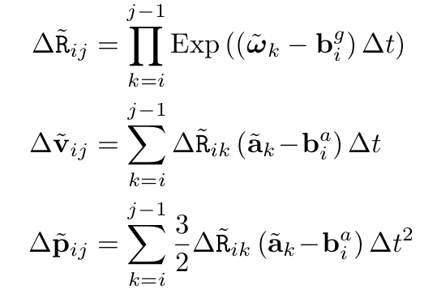
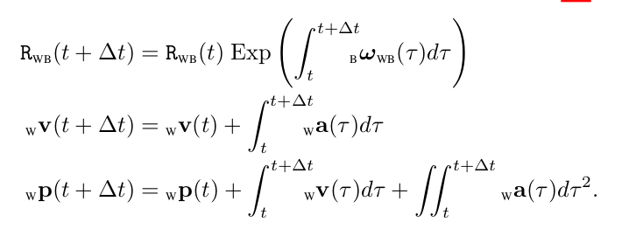
Theory of IMU Preintegration : Result
Eq. borrowed from [2]
Equations for IMU dead reckoning
Pseudo observations

Slide 23
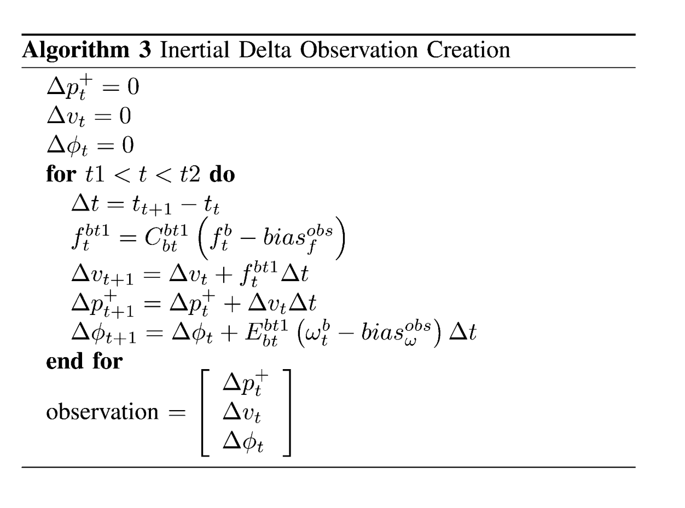
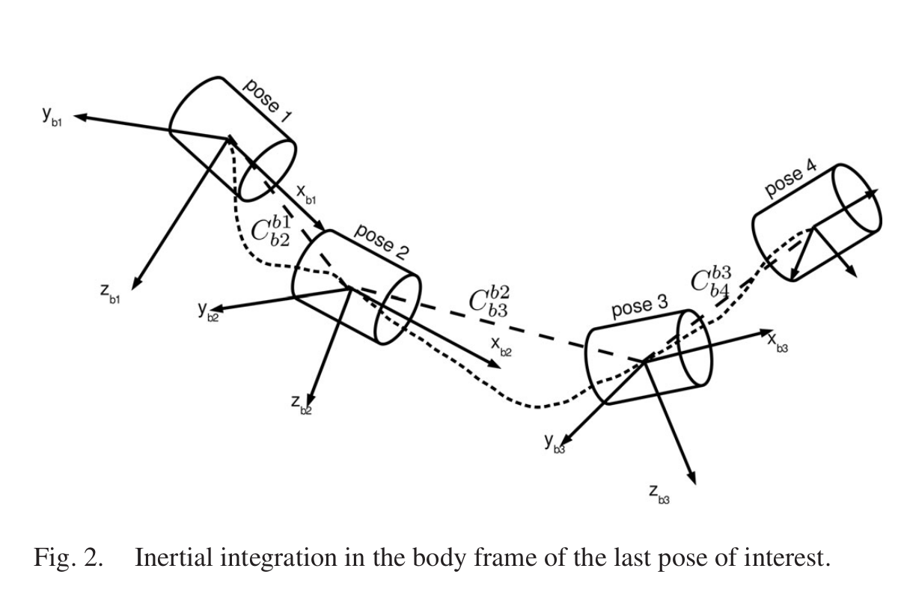
Effect of the Preintegration Theory

Slide 24
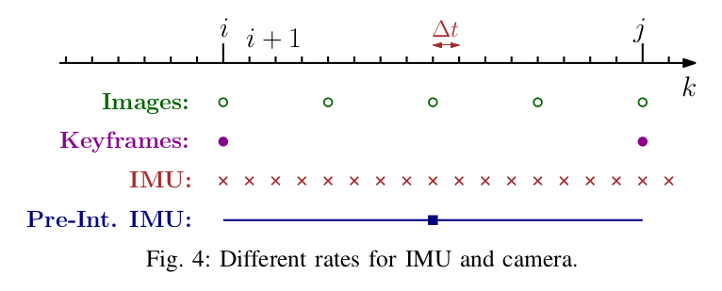
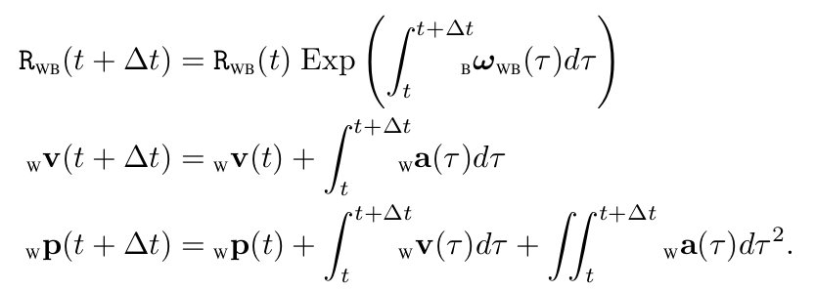
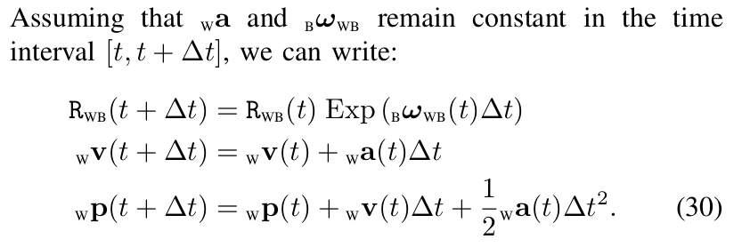
Details...
Eq. borrowed from [2]
...step: alpha
Eq of IMU dead reckoning
...step: beta
Assumption-1

Slide 25
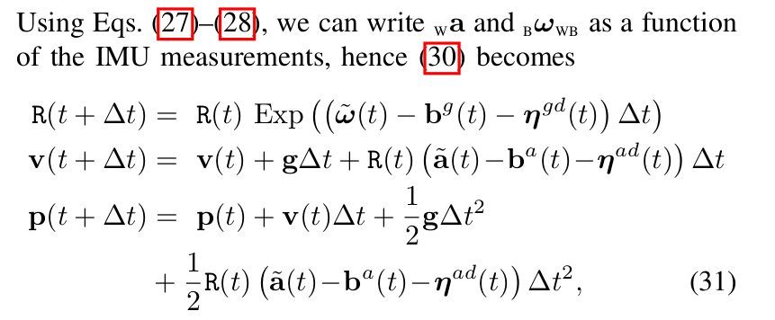
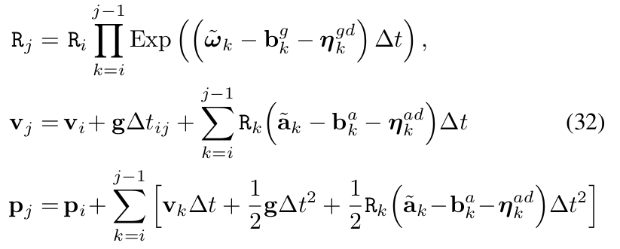
Details...2
...step: gamma
Substitute imu measurements in dead reckoning equations.
...step: delta
R( t+2d ) = R( t + d) * EXP(...)
R( t+3d ) = R(t+2d) * EXP(...)
…
R( t+nd) = R( t+(n-1)d ) * EXP(...)

Slide 26
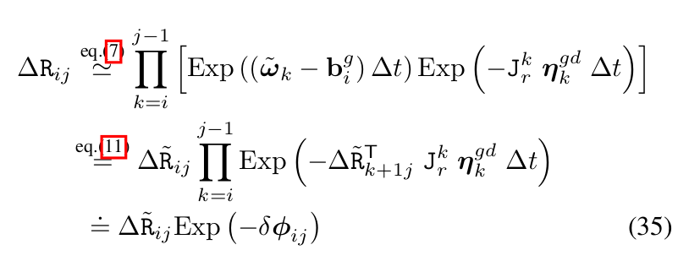
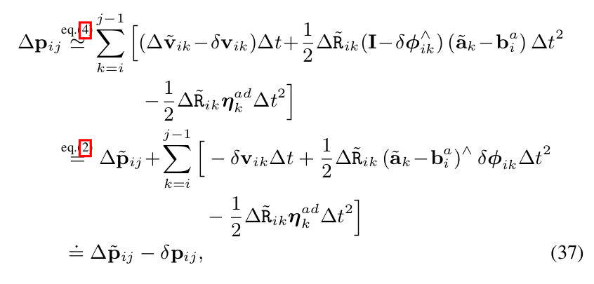
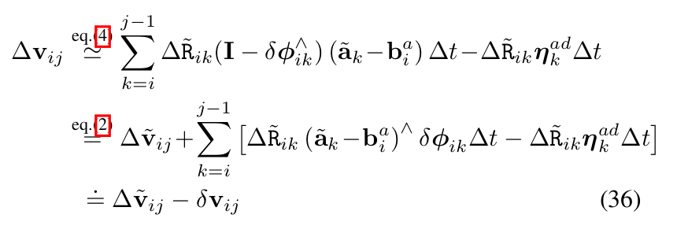
Details...3
Now, we want to separate out noise terms and also bias terms
...step: epsilon
First try to separate noise terms. This uses approximation for rotation matrix using Lie Groups and Lie Algebra. Some essential-to-know things are in Section-1 of [2].
The logic of having noise terms separated has to do with robustness of least squares fit. Let’s discuss the why some other time.

Slide 27
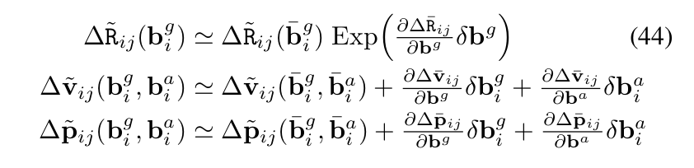
Details...4
...step: zeta
Use Taylor series approximation (1st order) to separate the variability of the bias terms

Slide 28
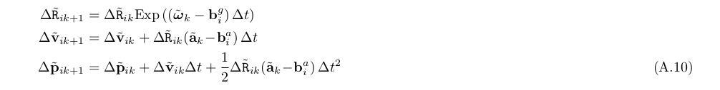
Final
Eq. borrowed from supplementary material to [2]
Incremental form
More convenient for robotics
Instead of i→j, i→k (each new imu measurement). Note i, j are legoloam measurements in our case
These are the imu observations
Pseudo IMU observations

Slide 29
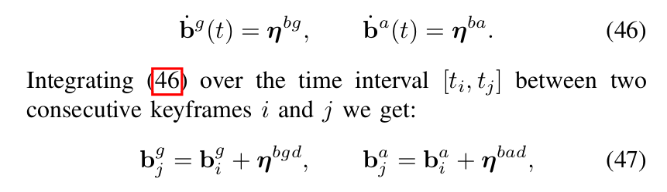
Bias Model
Biases usually vary with a rate (usually called in datasheet noise random walks)
Tip: To write continuous equations to discrete form, Euler Integration is in prevalent use. Above equations are precisely Euler Integration

Slide 30
IMU+LegoLOAM Sensor fusion as Non-Linear Least Squares

Slide 31
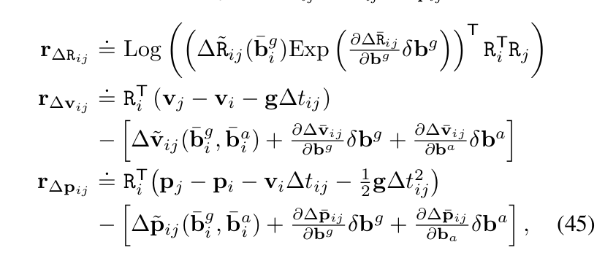
p_i, R_i, v_i, bg_i, ba_i → 15d in total
Optimization Variables?
[ X_0, X_1, X_2, …., X_i, ... X_n ], gravity (optional), calib (optional)
LegoLoam Poses: map_T_baseframe_i
Observations?
IMU Pseudo observations aka. IMU preintegrations
Residue from imu preintegrations
Residue?
Residue from legoloam
Initial Guess?
Bias residue

Slide 32
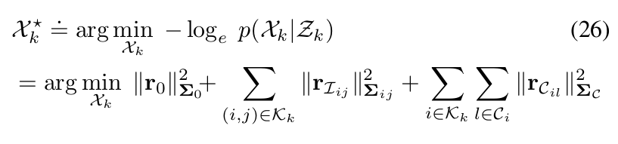
Final Optimization Problem
Prior factors
IMU factors
LegoLoam factors

Slide 33
Shall we look at our code?
I hope now you see why synced sensors are important in this context.
If time permits, let's look at the code and relate these equations to it>??
  GTSAM example code for IMU+GPS
    Data: https://github.com/borglab/gtsam/blob/develop/examples/Data/imuAndGPSdata.csv
    Code: https://github.com/borglab/gtsam/blob/develop/examples/ImuFactorsExample.cpp

